Slide 1





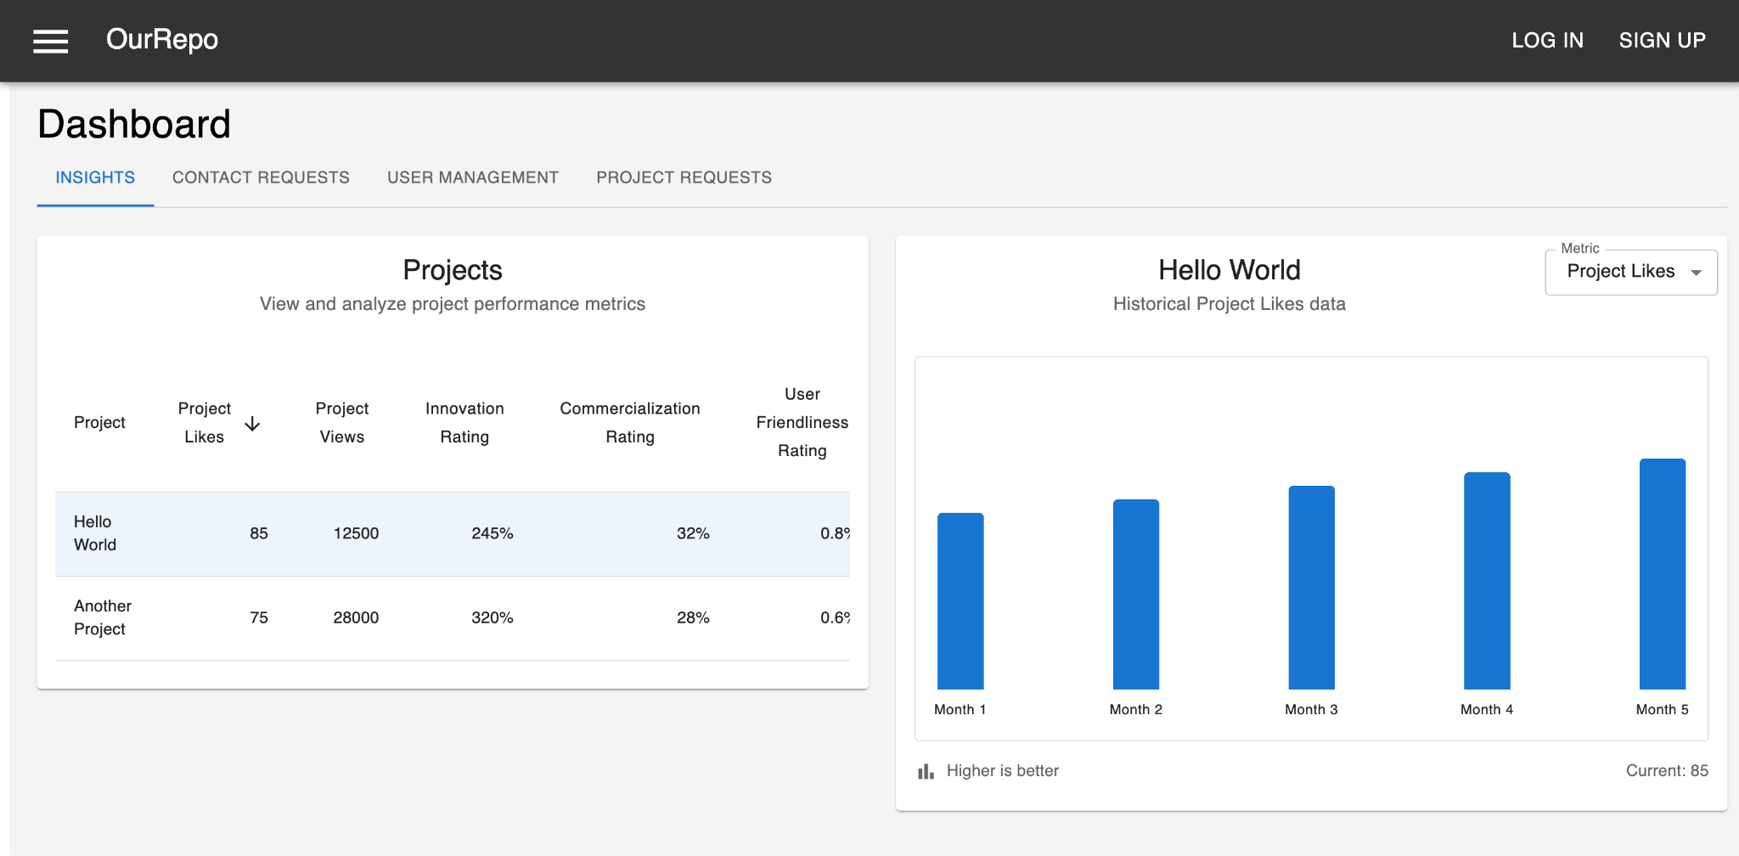
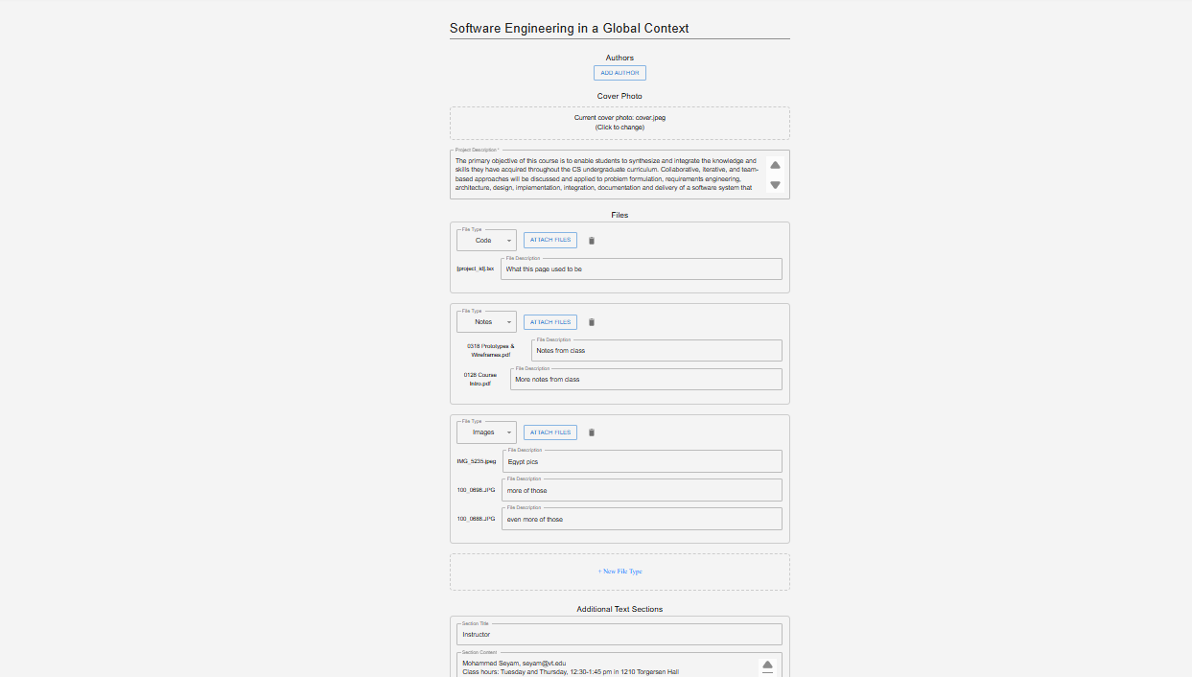

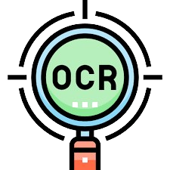
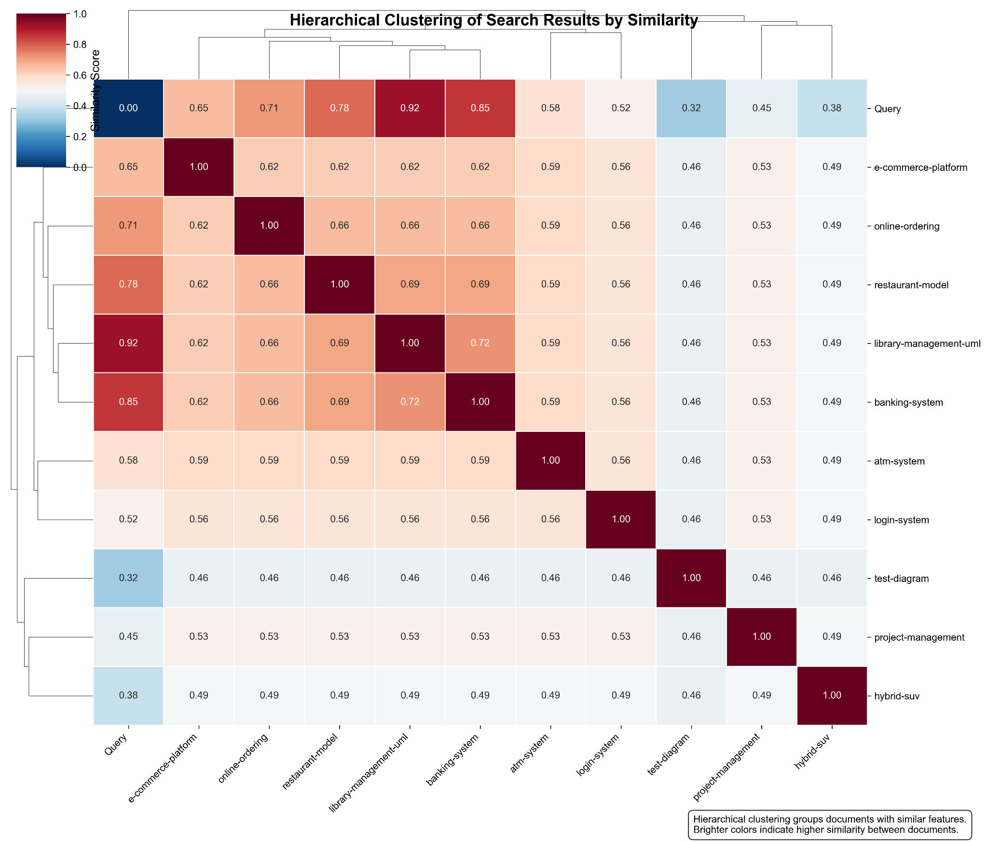
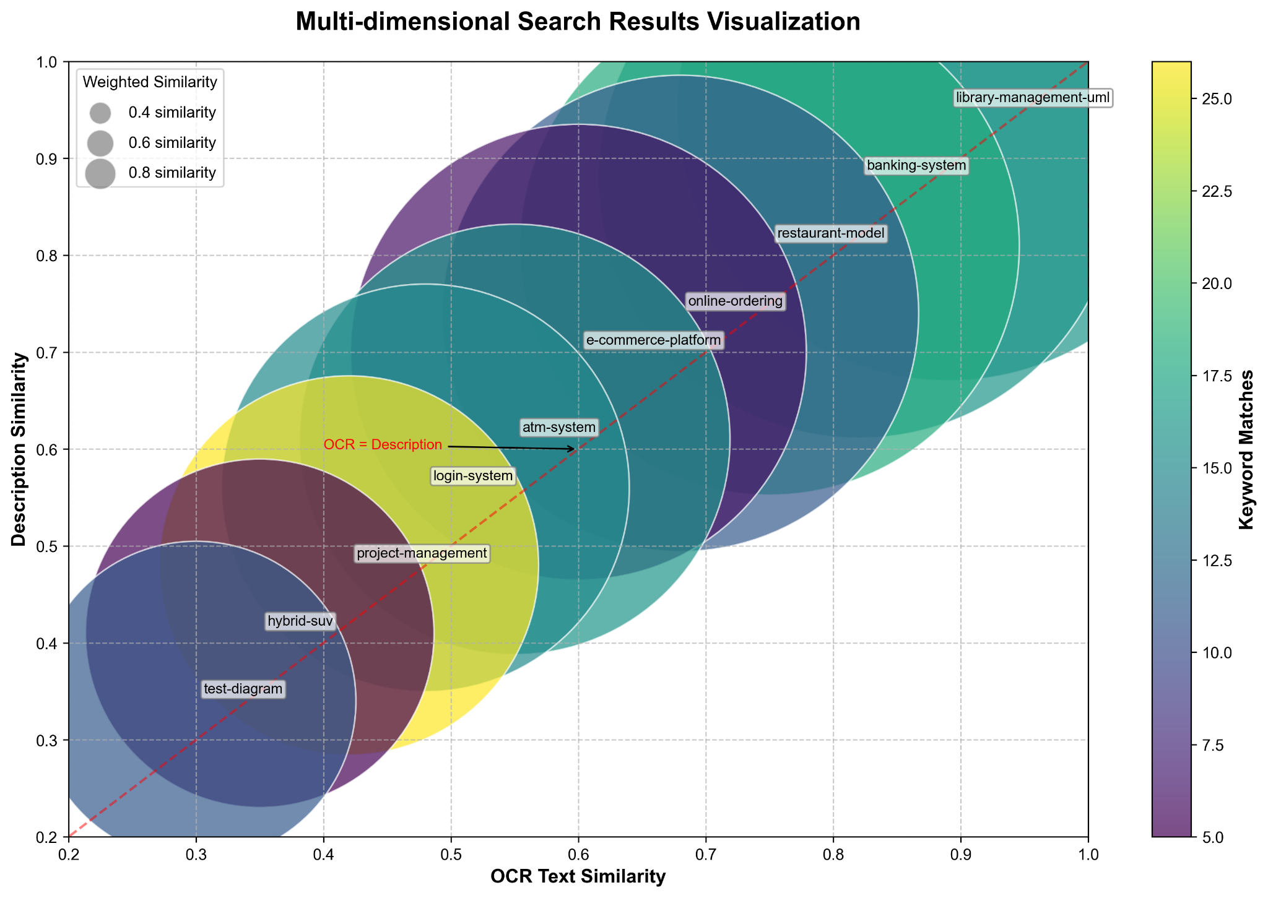

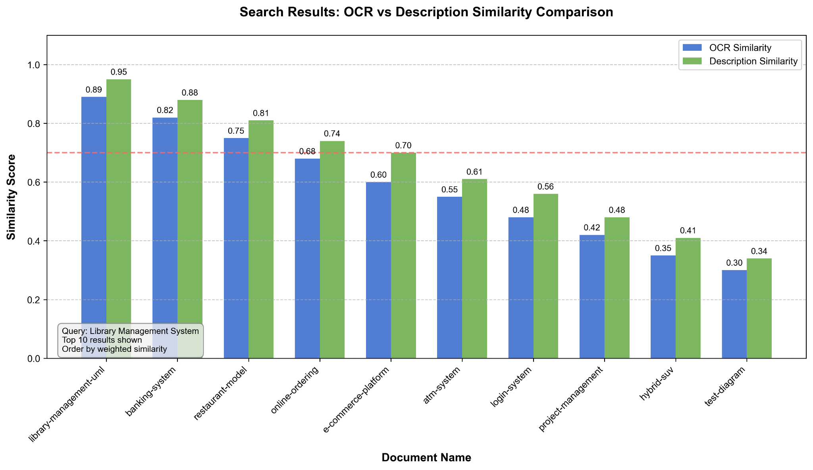

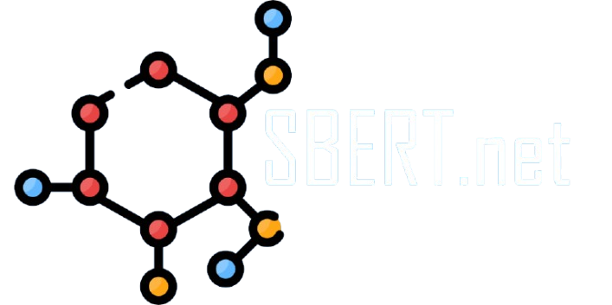
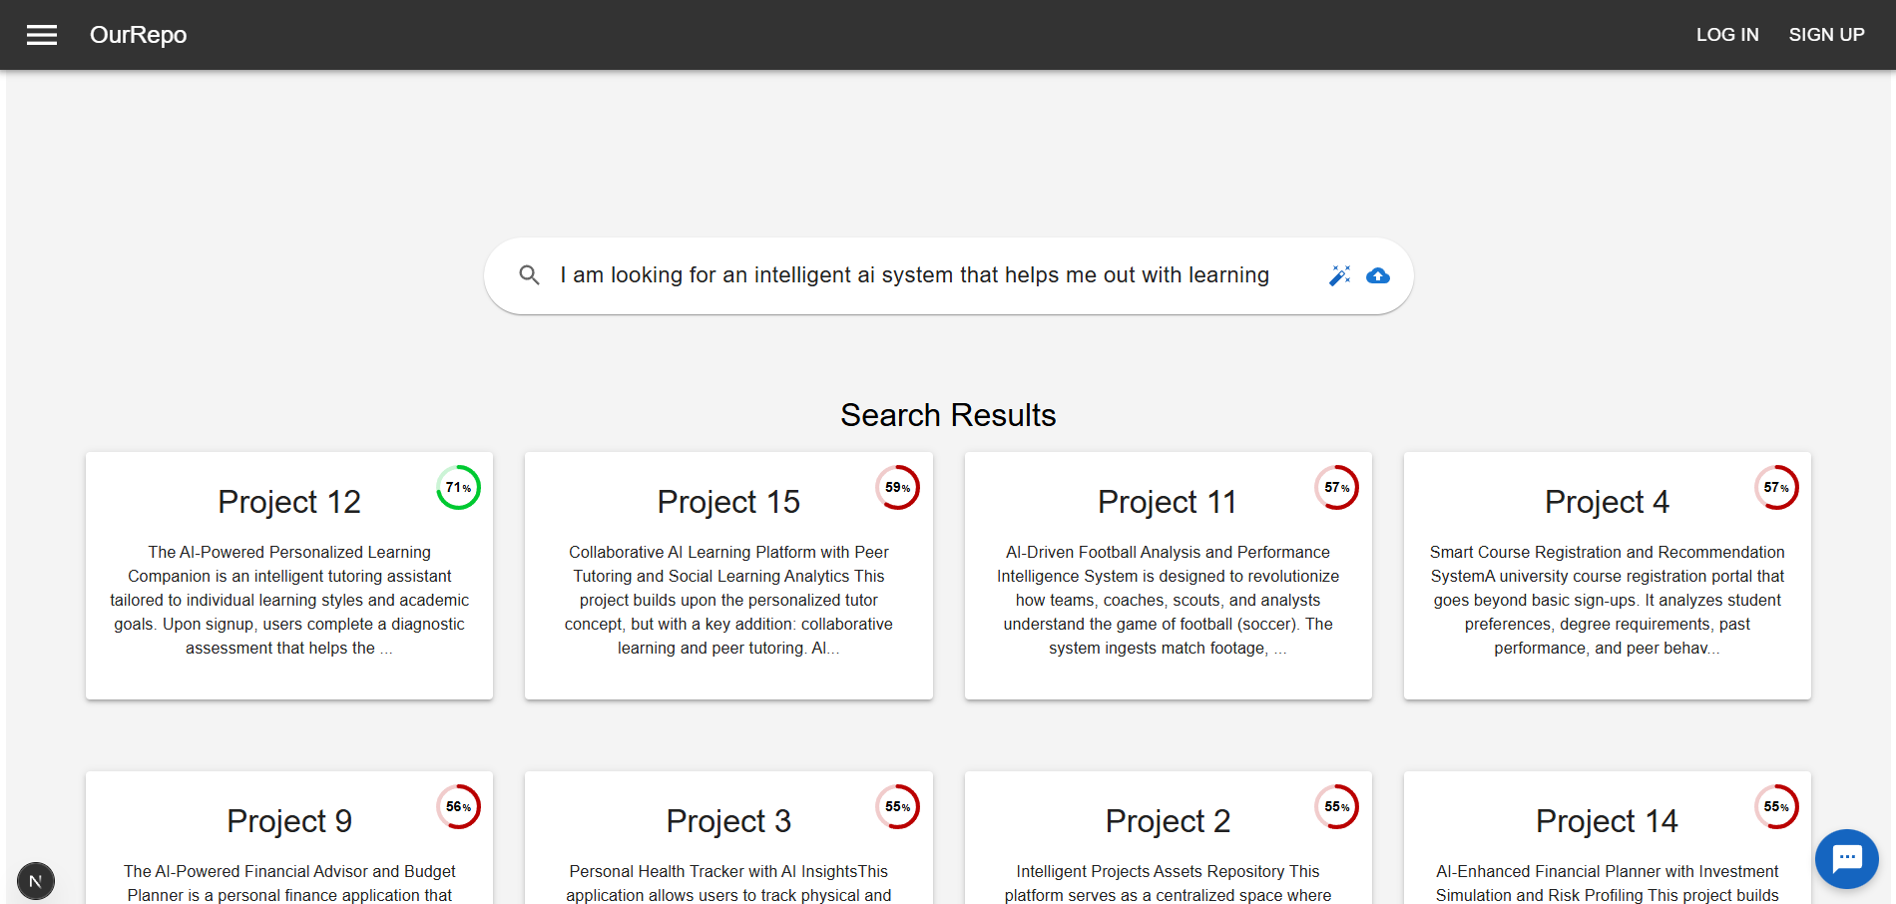

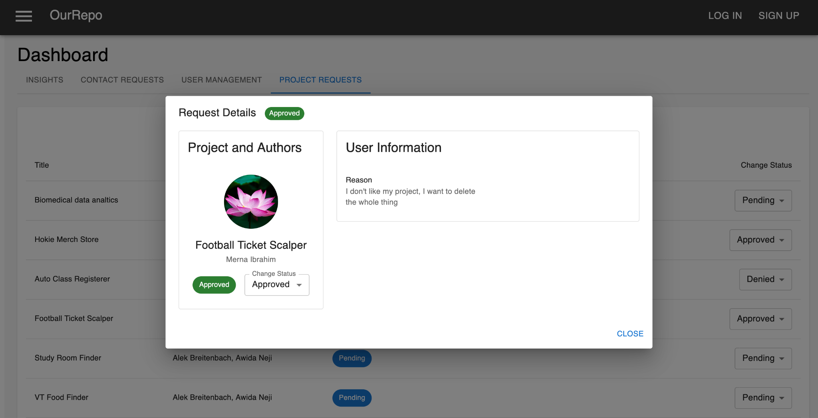
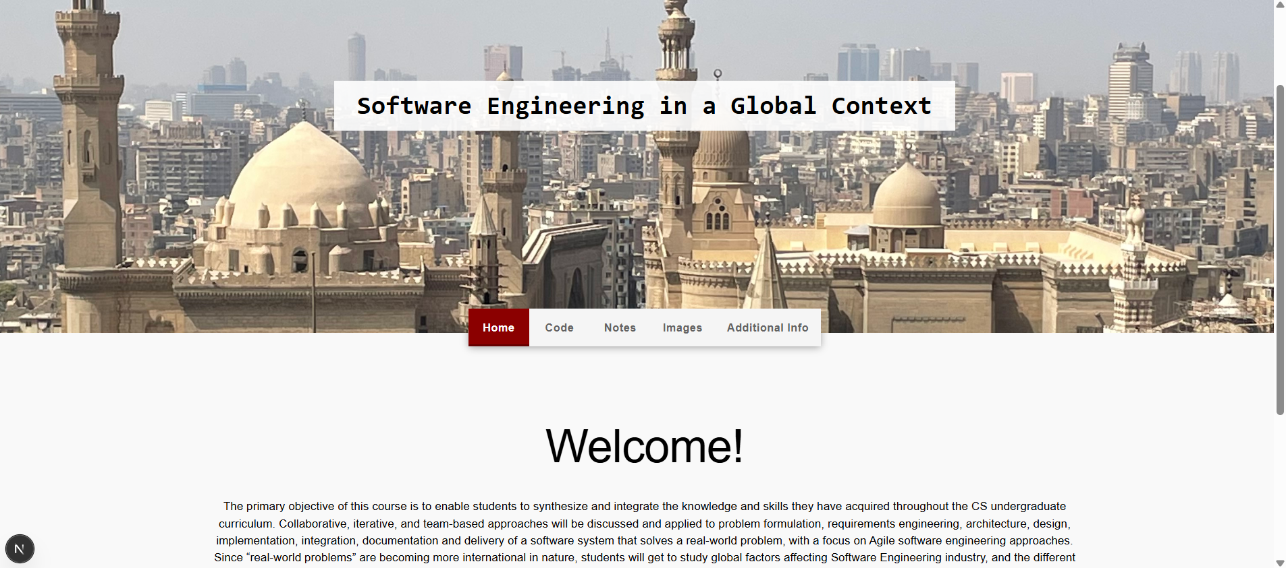











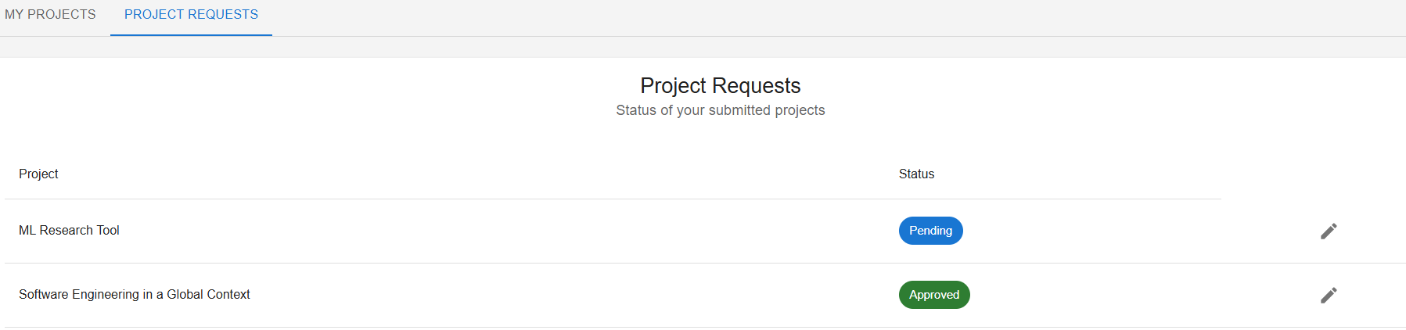



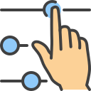




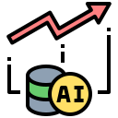
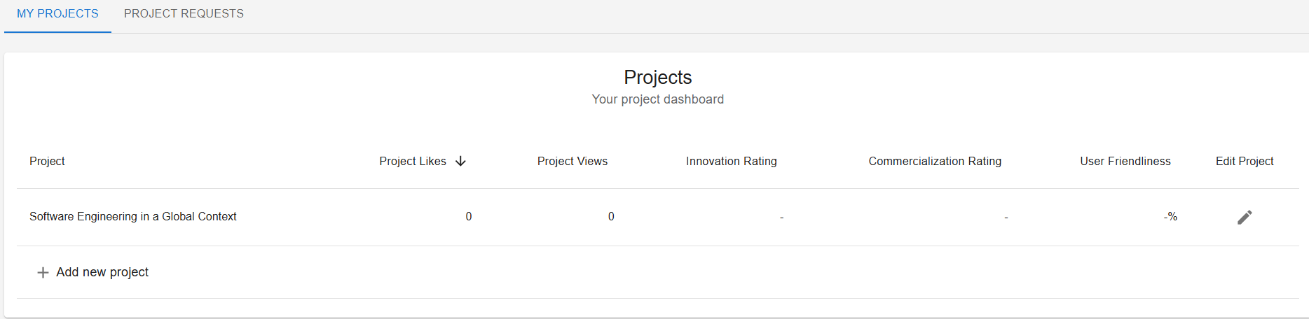



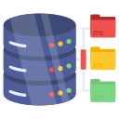





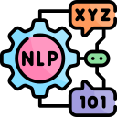
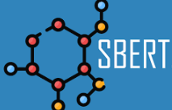
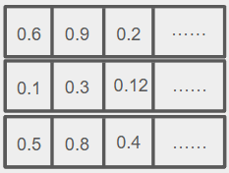





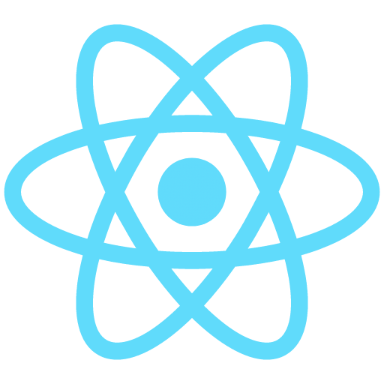
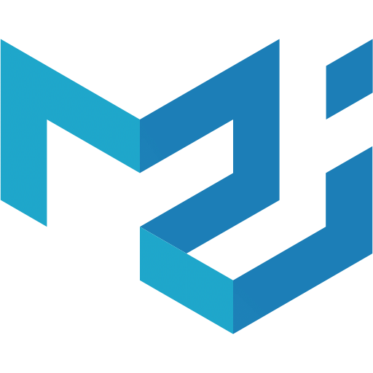
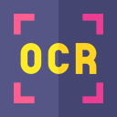
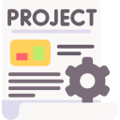

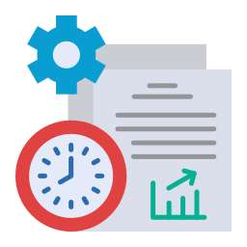



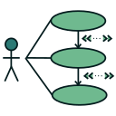
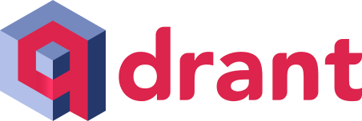








Software
Engineering
Capstone
An AI powered Repository: Enhancing Student Project Reuse and Discovery
Software Engineering Capstone
New
Version
An AI powered Repository: Enhancing Student Project Reuse and Discovery
Ahmed Islam, Aidan Flinton, Belal Fathy, Martha-Patience Taah, Merna Ibrahim- Faculty Advisor: Mohammed Seyam
Ahmed Islam, Aidan Flinton, Belal Fathy, Martha-Patience Taah, Merna Ibrahim- Faculty Advisor: Mohammed Seyam
Summary and Conclusion
Why it Matters
Project Form and Website
Summary and Conclusion
Why it Matters
Dashboards
Dashboards
Project Form and Website
This project presents a scalable, AI-powered platform designed to showcase, search, and commercialize student projects
Student projects are often underutilized, or lost after course completion
Duplication of effort remains common due to the lack of centralized discovery tools
Our platform introduces a scalable, AI-driven repository that empowers students to showcase their work while enabling others to efficiently discover and reuse existing assets
This project presents a scalable, AI-powered platform designed to showcase, search, and commercialize student projects
Student projects are often underutilized, or lost after course completion
Duplication of effort remains common due to the lack of centralized discovery tools
Our platform introduces a scalable, AI-driven repository that empowers students to showcase their work while enabling others to efficiently discover and reuse existing assets
We've focused on optimizing AI performance through extensive testing and thoughtful design, ensuring a seamless and intelligent user experience
We've focused on optimizing AI performance through extensive testing and thoughtful design, ensuring a seamless and intelligent user experience
Objective
Figure 1: Coordinator Dashboard view (Insights Page)
Figure 4: Project Edit/Upload Form
Objective
Figure 1: Coordinator Dashboard view (Insights Page)
An AI search system leveraging semantic understanding and structural diagram
analysis to retrieve relevant projects.
This intelligent discovery accelerates development and reduces redundancy
An AI search system leveraging semantic understanding and structural diagram
analysis to retrieve relevant projects.
This intelligent discovery accelerates development and reduces redundancy
The accuracy of our AI changes depending on the query, showing how it adapts to different questions for better results
Smart Diagram Search in Action
Centralized, scalable repository for student projects
Auto-generated web pages with code, diagrams, and documentation
Smart Diagram Search in Action
Centralized, scalable repository for student projects
Auto-generated web pages with code, diagrams, and documentation
Our platform helps students commercialize their work and enables others to easily discover, explore, and engage with innovative project
The platform helps students commercialize their work through coordinator-approved stakeholder access
Figure 2: Project upload request popup
Figure 5: Auto-generated project webpage
Figure 2: Project upload request popup
Figure 4: Project Similarity Result
Future Work
The accuracy of our AI changes depending on the query, showing how it adapts to different questions for better results
The platform helps students commercialize their work through coordinator-approved stakeholder access
Customizable project pages so students have complete control over the presentation of their project web pages if wanted
An AI chatbot refines searches, suggests similar projects, and guides users through project details
Our platform helps students commercialize their work and enables others to easily discover, explore, and engage with innovative project
Extend AI matching to include comparisons by overall shape and layout of the project
An AI chatbot refines searches, suggests similar projects, and guides users through project details
The Admin Dashboard lets coordinators manage the platform and oversee all activities, ensuring quality and security
Future Work
Customizable project pages so students have complete control over the presentation of their project web pages if wanted
Expand the platform for use across multiple institutions
The Admin Dashboard lets coordinators manage the platform and oversee all activities, ensuring quality and security
Figure 3: Student Dashboard
Figure 6: Result For Similarity search
Extend AI matching to include comparisons by overall shape and layout of the project
Our system integrates relational and vector database to store structured project info and support AI-powered semantic search through vector embeddings.
Figure 3: Student Dashboard
Figure 5: Auto-generated project webpage
Allow external partners to manage their platform interactions in the website
Query Text
Proposed AI Framework
Search With Embedding
Use The Embedding in order to compare with other embeddings in the vector database
Expand the platform for use across multiple institutions
Enhance Query
Preprocess Text
(Stop words, Lemmatization,punctuation,etc..)
Create Vector Embedding
Utilizing SBERT Sentence Transform Models
(paraphrase-Multilingual-mpnet-base-v2)
Proposed AI FrameWork
Search With Embedding
Use The Embedding in order to compare with other embeddings in the vector database
Query Text
Enhance Query
Preprocess Text
(Stop words, Lemmatization,punctuation,etc..)
Create Vector Embedding
Utilizing SBERT Sentence Transform Models
(paraphrase-Multilingual-mpnet-base-v2)
Connecting Campuses A US-Egypt Partnership
Tools Used
Allow external partners to manage their platform interactions in the website
Tools Used
This platform is a collaborative effort between Virginia Tech (USA) and Al Alamein International University (Egypt), uniting expertise across borders to build a globally scalable solution for academic project discovery and innovation
Website
DataBase
AI Models
Comparison is done using L2 (Euclidean distance)
Or Cosine Similarity
Connecting Campuses: A US-Egypt Partnership
Website
DataBase
AI Models
This platform is a collaborative effort between Virginia Tech (USA) and Al Alamein International University (Egypt), uniting expertise across borders to build a globally scalable solution for academic project discovery and innovation
Projects have their embedding already encoded and stored in the Vector database
Comparison is done using
L2 (Euclidean distance)
Or Cosine Similarity
React
MUI
SupaBase Database
Paddle OCR
Projects have their embedding already encoded and stored in the Vector database
React
MUI
SupaBase Database
Paddle OCR
FAISS
Extract Text
Using paddleocr
FAISS
Extract Text
Using paddleocr
Generate Description
Using LLM Models
Uml Diagrams
Generate Description
Using LLM Models
Store embeddings for AI Searching
Vector Database
Hugging
Face
OLLAMA
Uml Diagrams
Store embeddings for AI Searching
Next
backend
Vector Database
Hugging
Face
OLLAMA
Next
backend

Slide 2


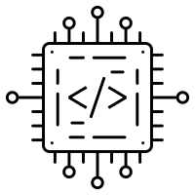


A Smarter Repository: Enhancing Student Project Reuse and Discovery
MYQuestions
Text Volume: Is there too little or too much text?
Color Choices: Are the colors appropriate and visually appealing?
Icons: Are there too many icons? Are they relevant to the content?
Font and Highlighting: Should the font be something standard like
Arial? Also, have I overused red highlights?
Background Design: Does the orange background behind the blocks work well, or does it conflict with poster regulations?
AI Results: I’d like to add AI results to the column on the right since numbers are fun but I’m unsure how to integrate them effectively.
Could you also tell me which blocks are good and which ones need tweaking and which ones that need complete redoing
Ahmed Islam, Aidan Flinton, Belal Fathy, Martha-Patience Taah, Merna Ibrahim- Faculty Advisor: Mohammed Seyam
Old
Version
Background
Problem Statement-Why it Matters
Dashboards
Project Form and Website
Summary and Conclusion
student projects are often underutilized, or lost after course completion.
Duplication of effort remains common due to the lack of centralized discovery tools
our platform introduces a scalable, AI-driven repository that empowers students to showcase their work while enabling others to efficiently discover and reuse existing assets.
This project presents a scalable, AI-powered platform designed to showcase, search, and commercialize academic student projects
Addresses Significant Problem : Tackles redundancy and promotes efficient resource utilization.
TBD
Objective
Figure 1: Coordinator Dashboard view (Insights Page)
An AI search system leveraging semantic understanding and structural diagram analysis to retrieve relevant projects.
This intelligent discovery accelerates development and reduces redundancy.
Future Work
Smart Diagram Search in Action
Customizable project pages so students have complete control over the presentation of their project web pages if wanted
Centralized, scalable repository for student projects
Auto-generated web pages with code, diagrams, and documentation
Extend AI Image-diagram matching to include comparisons by overall shape and layout
Figure 2: Project upload request popup
Figure 4: Project Upload Form
Expand the platform for use across multiple institutions
The platform enables students to commercialize their work by allowing vetted external stakeholders to request access through a coordinator-approved process, fostering real-world impact and academic recognition.
Allow external partners to manage their platform interactions in the website
Acknowledgements
Figure 3: Student Dashboard
Figure 5: Auto-generated project webpage
Special thank you to Dr. Mohammed Seyam got his support and guidance through the semester. We would also like to thank Al Alamein International University and Virginia Tech for facilitating this international collaboration.
An AI powered chatbot enhances the search experience by refining user queries, recommending similar projects, and guiding users through the details of any project they are
Query Text
Proposed AI Framework
Enhance Query
Preprocess Text
(Stop words, Lemmatization,punctuation,etc..)
Create Vector Embedding
Utilizing SBERT Sentence Transform Models
(paraphrase-Multilingual-mpnet-base-v2)
Search With Embedding
Use The Embedding in order to search in the vector database
Connecting Campuses A US-Egypt Partnership
This platform is a collaborative effort between Virginia Tech (USA) and Al Alamein International University (Egypt), uniting expertise across borders to build a globally scalable solution for academic project discovery and innovation.
An Admin Dashboard allows coordinators to review submissions, manage project visibility, and approve stakeholder access requests ensuring quality control and secure engagement
Projects have their embedding already encoded and stored in the Vector database
Uml Diagrams
Extract Text
Using paddleocr
Generate Description
Using LLM Models
FAISS
Store embeddings for AI Searching

